Slide 1
Indexing
and
Hashing

Slide 2
OUTLINE
Indexing: Basic Concepts
Evaluation Factors
Ordered Indices: Primary and Secondary
Dense and Sparse indices
Multilevel Indexing
B+ Tree Index Files
B-Tree Index Files
Hashing
Hash File Organization
Handling of Bucket Overflows
Open and Closed hashing
Hash Indices

Slide 3
Indexing and Hashing
Database Index
A data structure that improves the speed of data retrieval operations on a database table at the cost of slower writes and the use of more storage space.
Basic Concept
An index for a file in a database system works in much the same way as the index in this textbook. If we want to learn about a particular topic, we can search for the topic in the index at the back of the book, find the pages where it occurs, and then read the pages to find the information we are looking for. The words in the index are in sorted order, making it easy to find the word we are looking for. Moreover, the index is much smaller than the book, further reducing the effort needed to find the words we are looking for.

Slide 4
Indexing and Hashing
Types of Indices
There are two basic types of indices:
Ordered Indices
Hash Indices
Ordered Indices: Based on a sorted ordering of the values.
Hash Indices. Based on a uniform distribution of values across a range of buckets. The bucket to which a value is assigned is determined by a function, called a hash function.
Evaluation Factors
There are several techniques for both ordered indexing and hashing. No one technique is the best. Rather, each technique is best suited to particular database applications. Each technique must be evaluated on the basis of the following factors:

Slide 5
Indexing and Hashing
Evaluation Factors
Access Types: Access types can include finding records with a specified attribute value and finding records whose attribute values fall in a specified range.
Access Time: The time it takes to find a particular data item, or set of items, using the technique in question.
Insertion Time: The time it takes to insert a new data item. This value includes the time it takes to find the correct place to insert the new data item, as well as the time it takes to update the index structure.

Slide 6
Indexing and Hashing
Evaluation Factors
Deletion time: The time it takes to delete a data item. This value includes the time it takes to find the item to be deleted, as well as the time it takes to update the index structure.
Space overhead: The additional space occupied by an index structure. Provided that the amount of additional space is moderate, it is usually worthwhile to sacrifice the space to achieve improved performance.

Slide 7
Indexing and Hashing
Search Key
An attribute or set of attributes used to look up records in a file is called a search key.
Ordered Indices
To gain fast random access to records in a file, we can use an index structure.
Each index structure is associated with a particular search key.
An ordered index stores the values of the search keys in sorted order, and associates with each search key the records that contain it.
A file may have several indices, on different search keys.

Slide 8
Indexing and Hashing
Ordered Indices
Primary Index
Secondary Index
Primary Index: If the file containing the records is sequentially ordered, a primary index is an index whose search key also defines the sequential order of the file.
Primary indices are also called clustering indices.
Types: Dense and Sparse

Slide 9
Indexing and Hashing
Dense Index
An index record appears for every search-key value in the file.
In a dense primary index, the index record contains the search-key value and a pointer to the first data record with that search-key value.
The rest of the records with the same search key-value would be stored sequentially after the first record, because the index is a primary one, records are sorted on the same search key.

Slide 10
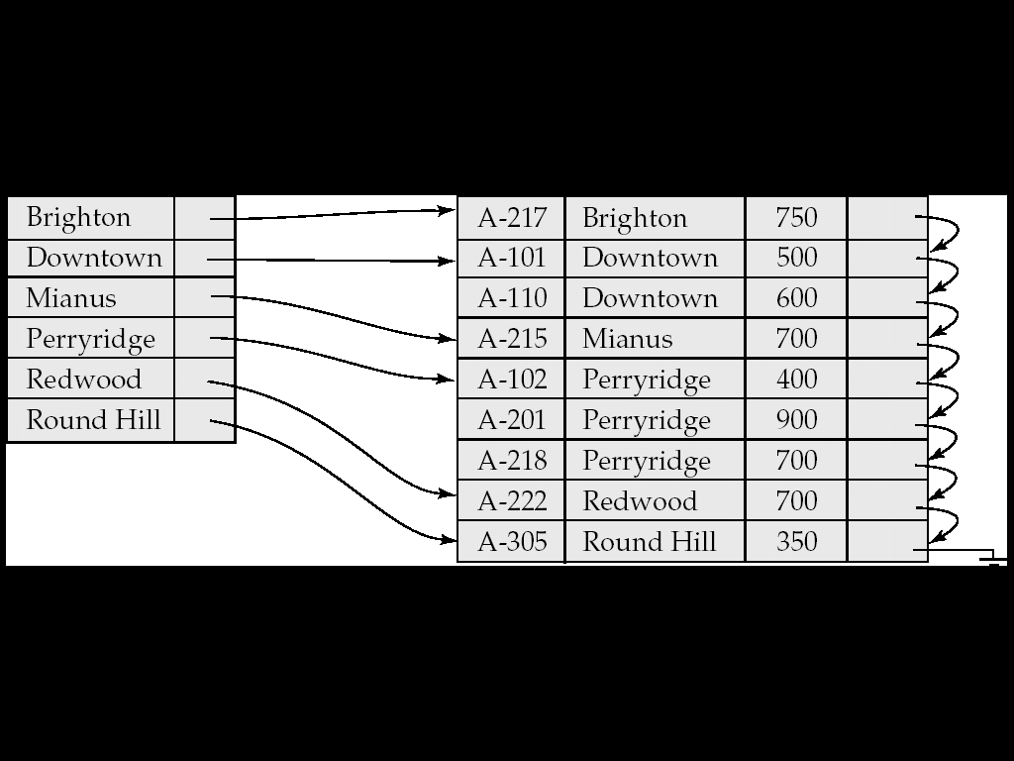
Indexing and Hashing
Dense Index

Slide 11
Indexing and Hashing
Sparse Index
An index record appears for only some of the search-key values.
Each index record contains a search-key value and a pointer to the first data record with that search-key value.
To locate a record, we find the index entry with the largest search-key value that is less than or equal to the search-key value for which we are looking.
We start at the record pointed to by that index entry, and follow the pointers in the file until we find the desired record.

Slide 12
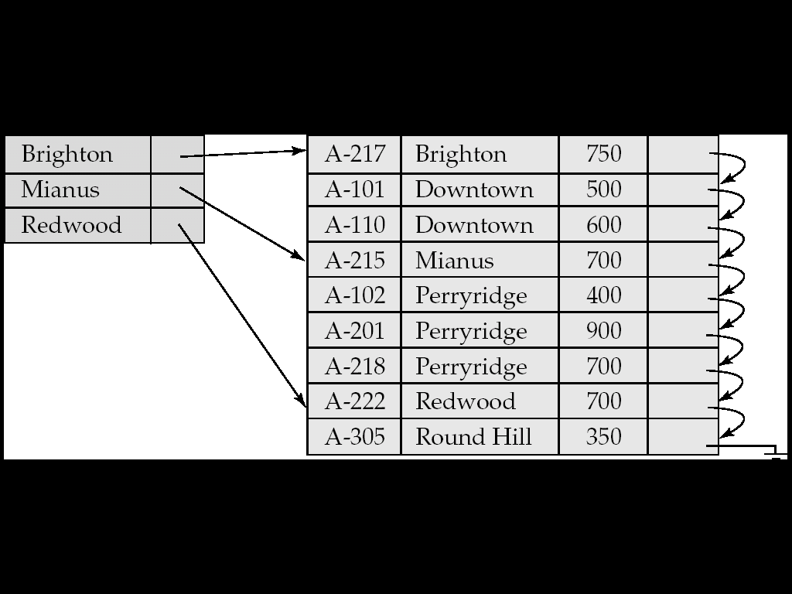
Indexing and Hashing
Sparse Index

Slide 13
Indexing and Hashing
Dense VS Sparse Indices
It is generally faster to locate a record if we have a dense index rather than a sparse index.
However, sparse indices have advantages over dense indices in that they require less space and they impose less maintenance overhead for insertions and deletions.
There is a trade-off that the system designer must make between access time and space overhead.

Slide 14
Indexing and Hashing
Multi-Level Indices
If primary index does not fit in memory, access becomes expensive.
Solution: treat primary index kept on disk as a sequential file and construct a sparse index on it.
- Outer index – a sparse index of primary index
- Inner index – the primary index file
If even outer index is too large to fit in main memory, yet another level of index can be created, and so on.
Indices at all levels must be updated on insertion or deletion from the file.

Slide 15
Indexing and Hashing
Multi-Level Indices: An Example
Consider 100,000 records, 10 per block, at one index record per block, that's 10,000 index records. Even if we can fit 100 index records per block, this is 100 blocks. If index is too large to be kept in main memory, a search results in several disk reads.
For very large files, additional levels of indexing may be required.
Indices must be updated at all levels when insertions or deletions require it.
Frequently, each level of index corresponds to a unit of physical storage.

Slide 16
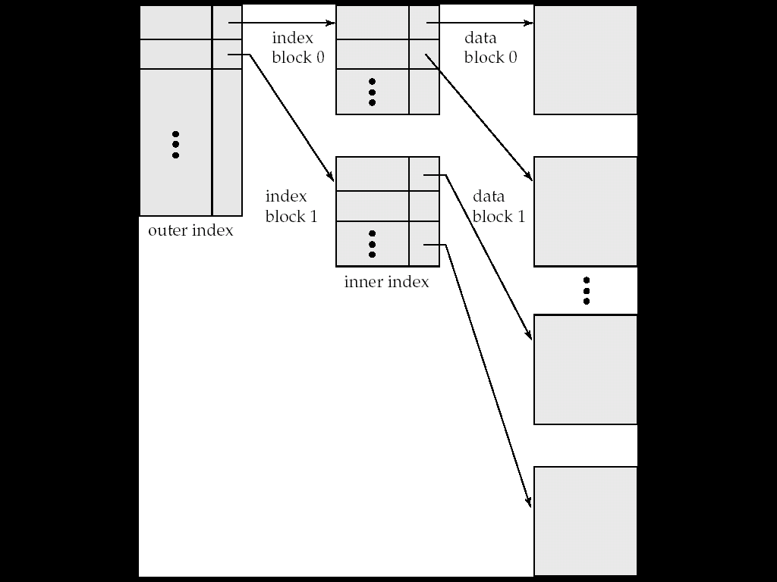
Indexing and Hashing
Multi-Level Indices: An Example

Slide 17
Indexing and Hashing
Secondary Index
Indices whose search key specifies an order different from the sequential order of the file are called secondary indices, or non-clustering indices.
Secondary indices must be dense with an index entry for every search-key value, and a pointer to every record in the file.

Slide 18
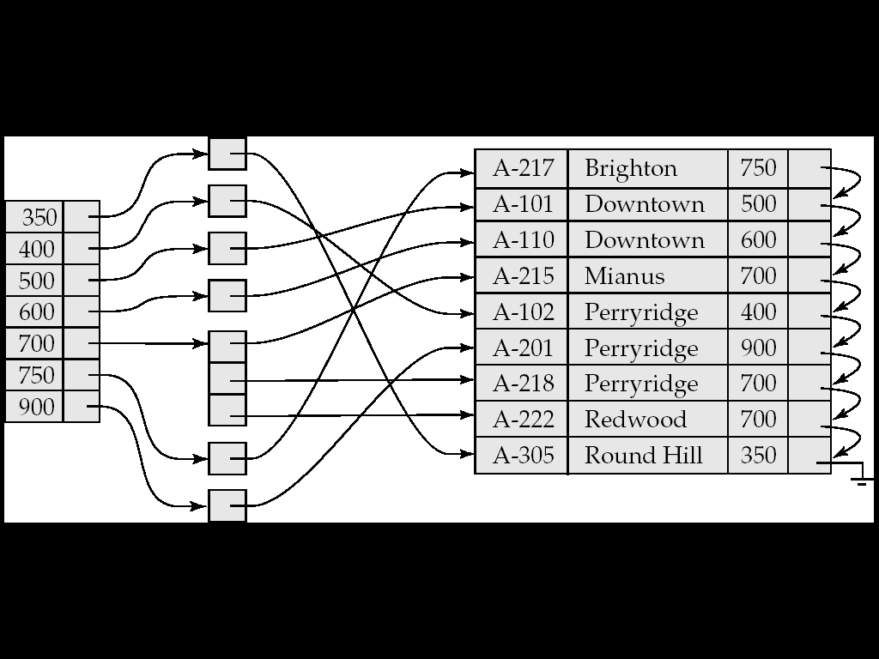
Indexing and Hashing
Secondary Index

Slide 19
Indexing and Hashing
Primary VS Secondary Indices
A sequential scan in primary index order is efficient because records in the file are stored physically in the same order as the index order.
Secondary indices improve the performance of queries that use keys other than the search key of the primary index. However, they impose a significant overhead on modification of the database. The designer of a database decides which secondary indices are desirable on the basis of an estimate of the relative frequency of queries and modifications.
The primary index is on the field which specifies the sequential order of the data file.
There can be only one primary index while there can be many secondary indices.

Slide 20
Indexing and Hashing
B+ Tree Index Files
The main disadvantage of the index-sequential file organization is that performance degrades as the file grows, both for index lookups and for sequential scans through the data. To over come this deficiency, we use a B⁺ tree index.
The B+ tree index structure is the most widely used of several index structures that maintain their efficiency despite insertion and deletion of data.
This is a balanced tree in which every path from the root of the tree to a leaf of the tree is of the same length.
A B+ tree index is a multilevel index. A typical node of a B+tree is shown below.

Slide 21
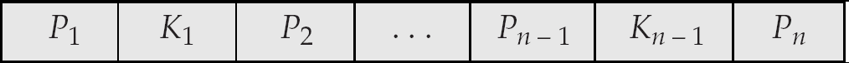
Indexing and Hashing
B+ Tree Index Files
A B+ tree index is a multilevel index. A typical node of a B+-tree is shown below.
Each node that is not a root or a leaf has between ⎡n/2⎤ and n children.
A leaf node has between ⎡(n–1)/2⎤ and n–1 values
Special cases:
- If the root is not a leaf, it has at least 2 children.
- If the root is a leaf (that is, there are no other nodes in the tree),
it can have between 0 and (n–1) values.

Slide 22
Indexing and Hashing
B+ Tree Index Files
It contains up to n − 1 search-key values K₁, K₂, . . .,K_{n−1}, and n pointers P₁, P₂, . . . ,P_{n.}
The search-keys in a node are ordered: K₁ < K₂ < K₃ < . . . < K_{n–1}
For leaf nodes, for i = 1, 2, . . . , n − 1, pointer P_{i} points to either a file record with search-key value K_{i} or to a bucket of pointers, each of which points to a file record with search-key value K_{i}.

Slide 23
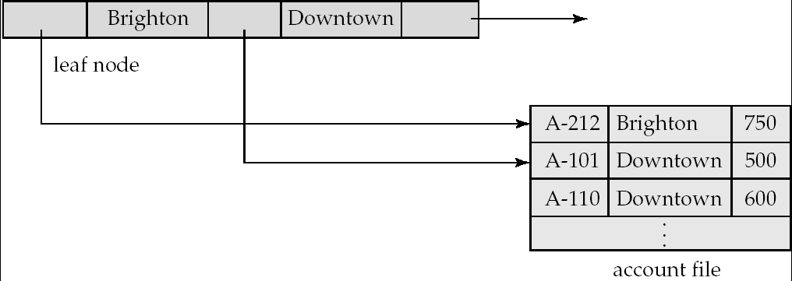
Indexing and Hashing
B+ Tree Index Files
A non-leaf node may hold up to n pointers, and must hold at least ⎡n/2⎤ pointers.
The number of pointers in a node is called the fanout of the node.
The root node can hold fewer than ⎡n/2⎤ pointers. However, it must hold at least two pointers.

Slide 24
Indexing and Hashing
Construct a B+ tree for the following set of key values:
(2, 3, 5, 7, 11, 17, 19, 23, 29, 31) for n=4 and n=6.
Solution: Construction of B+ tree for order n=4.
Search key values =3, Pointers= 4.
Insert key value 2:
Insert key value 3:
 | 2
 | 2 |  | 3

Slide 25
Indexing and Hashing
Construct a B+ tree for the following set of key values:
(2, 3, 5, 7, 11, 17, 19, 23, 29, 31) for n=4 and n=6.
Insert key value 5:
Insert key value 7: Split the node.
 | 2 |  | 3 |  | 5
 | 5
 | 2 |  | 3
 | 5 |  | 7

Slide 26
Indexing and Hashing
Construct a B+ tree for the following set of key values:
(2, 3, 5, 7, 11, 17, 19, 23, 29, 31) for n=4 and n=6.
Insert key value 11:
Insert key value 17: Split the node.
 | 5
 | 2 |  | 3
 | 5 |  | 7 |  | 11
 | 5 |  | 11
 | 2 |  | 3
 | 5 |  | 7
 | 11 |  | 17

Slide 27
Indexing and Hashing
Construct a B+ tree for the following set of key values:
(2, 3, 5, 7, 11, 17, 19, 23, 29, 31) for n=4 and n=6.
Insert key value 19:
Insert key value 23: Split the node.
 | 5 |  | 11
 | 2 |  | 3
 | 5 |  | 7
 | 11 |  | 17 |  | 19
 | 5 |  | 11 |  | 19
 | 2 |  | 3
 | 5 |  | 7
 | 11 |  | 17
 | 19 |  | 23

Slide 28
Indexing and Hashing
Construct a B+ tree for the following set of key values:
(2, 3, 5, 7, 11, 17, 19, 23, 29, 31) for n=4 and n=6.
Insert key value 29:
 | 5 |  | 11 |  | 19
 | 2 |  | 3
 | 5 |  | 7
 | 11 |  | 17
 | 19 |  | 23 |  | 29

Slide 29
Indexing and Hashing
Construct a B+ tree for the following set of key values:
(2, 3, 5, 7, 11, 17, 19, 23, 29, 31) for n=4 and n=6.
Insert key value 31:
 | 19
 | 5 |  | 11
 | 29
 | 2 |  | 3
 | 5 |  | 7
 | 11 |  | 17
 | 19 |  | 23
 | 29 |  | 31

Slide 30
Indexing and Hashing
Construct a B+-tree for the following set of key values:
(2, 3, 5, 7, 11, 17, 19, 23, 29, 31) for n=4 and n=6.
For n=6:
7
19
2
3
5
7
11
17
19
23
29
31

Slide 31
Indexing and Hashing
Example: a) Construct a B+ tree for the following set of key values for n=5:
5, 10, 15, 20, 25, 30, 35, 40, 50, 55, 65, 70, 75, 80, 90, 95
b) Show how the B+ tree changes as the result of each of the following operations:
i. Insert 60
ii. Delete 65

Slide 32
Indexing and Hashing
Example: a) Construct a B+ tree for the following set of key values for n=5:
5, 10, 15, 20, 25, 30, 35, 40, 50, 55, 65, 70, 75, 80, 90, 95
b) Show how the B+ tree changes as the result of each of the following operations:
i. Insert 60
ii. Delete 65
Solution: a) Construction of B+ tree for order n=5.
Search key values =4, Pointers= 5.
Insert key value 5, 10, 15, 20:
 | 5 |  | 10 |  | 15 |  | 20

Slide 33
Indexing and Hashing
Example: a) Construct a B+ tree for the following set of key values for n=5:
5, 10, 15, 20, 25, 30, 35, 40, 50, 55, 65, 70, 75, 80, 90, 95
b) Show how the B+ tree changes as the result of each of the following operations:
i. Insert 60
ii. Delete 65
Solution: Insert key value 25:
Split the node and insert.
Ceil ((n-1)/2) = 2
Insert key value 30:
 | 15
 | 5 |  | 10
 | 15 |  | 20 |  | 25
 | 15
 | 5 |  | 10
 | 15 |  | 20 |  | 25 |  | 30

Slide 34
Indexing and Hashing
Example: a) Construct a B+ tree for the following set of key values for n=5:
5, 10, 15, 20, 25, 30, 35, 40, 50, 55, 65, 70, 75, 80, 90, 95
b) Show how the B+ tree changes as the result of each of the following operations:
i. Insert 60
ii. Delete 65
Solution: Insert key value 35:
Split the node and insert.
After re-arranging nodes.
 | 15 |  | 25
 | 5 |  | 10
 | 15 |  | 20
 | 25 |  | 30 |  | 35
 | 25
 | 5 |  | 10 |  | 15 |  | 20
 | 25 |  | 30 |  | 35

Slide 35
Indexing and Hashing
Example: a) Construct a B+ tree for the following set of key values for n=5:
5, 10, 15, 20, 25, 30, 35, 40, 50, 55, 65, 70, 75, 80, 90, 95
b) Show how the B+ tree changes as the result of each of the following operations:
i. Insert 60
ii. Delete 65
Solution: Insert key value 40:
Insert key value 50:
Split the node and insert.
 | 25
 | 5 |  | 10 |  | 15 |  | 20
 | 25 |  | 30 |  | 35 |  | 40
 | 25 |  | 35
 | 5 |  | 10 |  | 15 |  | 20
 | 25 |  | 30
 | 35 |  | 40 |  | 50

Slide 36
Indexing and Hashing
Example: a) Construct a B+ tree for the following set of key values for n=5:
5, 10, 15, 20, 25, 30, 35, 40, 50, 55, 65, 70, 75, 80, 90, 95
b) Show how the B+ tree changes as the result of each of the following operations:
i. Insert 60
ii. Delete 65
Solution: Insert key value 55:
 | 25 |  | 35
 | 5 |  | 10 |  | 15 |  | 20
 | 25 |  | 30
 | 35 |  | 40 |  | 50 |  | 55

Slide 37
Indexing and Hashing
Example: a) Construct a B+ tree for the following set of key values for n=5:
5, 10, 15, 20, 25, 30, 35, 40, 50, 55, 65, 70, 75, 80, 90, 95
b) Show how the B+ tree changes as the result of each of the following operations:
i. Insert 60
ii. Delete 65
Solution: Insert key value 65: Split the node and insert.
 | 25 |  | 35 |  | 50
 | 5 |  | 10 |  | 15 |  | 20
 | 50 |  | 55 |  | 65
 | 35 |  | 40
 | 25 |  | 30

Slide 38
Indexing and Hashing
Example: a) Construct a B+ tree for the following set of key values for n=5:
5, 10, 15, 20, 25, 30, 35, 40, 50, 55, 65, 70, 75, 80, 90, 95
b) Show how the B+ tree changes as the result of each of the following operations:
i. Insert 60
ii. Delete 65
Solution: After re-arranging nodes:
Insert key value 70:
 | 25 |  | 50
 | 5 |  | 10 |  | 15 |  | 20
 | 25 |  | 30 |  | 35 |  | 40
 | 50 |  | 55 |  | 65
 | 25 |  | 50
 | 5 |  | 10 |  | 15 |  | 20
 | 25 |  | 30 |  | 35 |  | 40
 | 50 |  | 55 |  | 65 |  | 70

Slide 39
Indexing and Hashing
Example: a) Construct a B+ tree for the following set of key values for n=5:
5, 10, 15, 20, 25, 30, 35, 40, 50, 55, 65, 70, 75, 80, 90, 95
b) Show how the B+ tree changes as the result of each of the following operations:
i. Insert 60
ii. Delete 65
Solution: Insert key value 75: Split the node and insert.
 | 25 |  | 50 |  | 65
 | 5 |  | 10 |  | 15 |  | 20
 | 65 |  | 70 |  | 75
 | 50 |  | 55
 | 25 |  | 30 |  | 35 |  | 40

Slide 40
Indexing and Hashing
Example: a) Construct a B+ tree for the following set of key values for n=5:
5, 10, 15, 20, 25, 30, 35, 40, 50, 55, 65, 70, 75, 80, 90, 95
b) Show how the B+ tree changes as the result of each of the following operations:
i. Insert 60
ii. Delete 65
Solution: Insert key value 80:
 | 25 |  | 50 |  | 65
 | 5 |  | 10 |  | 15 |  | 20
 | 65 |  | 70 |  | 75 |  | 80
 | 50 |  | 55
 | 25 |  | 30 |  | 35 |  | 40

Slide 41
Indexing and Hashing
Example: a) Construct a B+ tree for the following set of key values for n=5:
5, 10, 15, 20, 25, 30, 35, 40, 50, 55, 65, 70, 75, 80, 90, 95
b) Show how the B+ tree changes as the result of each of the following operations:
i. Insert 60
ii. Delete 65
Solution: Insert key value 90: Split the node and insert.
 | 25 |  | 50 |  | 65 |  | 75
 | 75 |  | 80 |  | 90
 | 5 |  | 10 |  | 15 |  | 20
 | 65 |  | 70
 | 50 |  | 55
 | 25 |  | 30 |  | 35 |  | 40

Slide 42
Indexing and Hashing
Example: a) Construct a B+ tree for the following set of key values for n=5:
5, 10, 15, 20, 25, 30, 35, 40, 50, 55, 65, 70, 75, 80, 90, 95
b) Show how the B+ tree changes as the result of each of the following operations:
i. Insert 60
ii. Delete 65
Solution: After re-arranging nodes:
 | 25 |  | 50 |  | 75
 | 5 |  | 10 |  | 15 |  | 20
 | 75 |  | 80 |  | 90
 | 50 |  | 55 |  | 65 |  | 70
 | 25 |  | 30 |  | 35 |  | 40

Slide 43
Indexing and Hashing
Example: a) Construct a B+ tree for the following set of key values for n=5:
5, 10, 15, 20, 25, 30, 35, 40, 50, 55, 65, 70, 75, 80, 90, 95
b) Show how the B+ tree changes as the result of each of the following operations:
i. Insert 60
ii. Delete 65
Solution: Insert key value 95:
Final B+ tree.
 | 25 |  | 50 |  | 75
 | 5 |  | 10 |  | 15 |  | 20
 | 75 |  | 80 |  | 90 |  | 95
 | 50 |  | 55 |  | 65 |  | 70
 | 25 |  | 30 |  | 35 |  | 40

Slide 44
Indexing and Hashing
Example: b) Show how the B+ tree changes as the result of each of the following operations:
i. Insert 60 ii. Delete 65
Solution: Insert key value 60:
60 will go to the 3rd node after 55. The node of is already full. So, split the node and insert 60.
 | 25 |  | 50 |  | 75
 | 5 |  | 10 |  | 15 |  | 20
 | 75 |  | 80 |  | 90 |  | 95
 | 50 |  | 55 |  | 65 |  | 70
 | 25 |  | 30 |  | 35 |  | 40
60

Slide 45
Indexing and Hashing
Example: b) Show how the B+ tree changes as the result of each of the following operations:
i. Insert 60 ii. Delete 65
Solution: Split the 3rd node and insert 60.
 | 25 |  | 50 |  | 60 |  | 75
 | 5 |  | 10 |  | 15 |  | 20
 | 75 |  | 80 |  | 90 |  | 95
 | 60 |  | 65 |  | 70
 | 25 |  | 30 |  | 35 |  | 40
 | 50 |  | 55

Slide 46
Indexing and Hashing
Example: b) Show how the B+ tree changes as the result of each of the following operations:
i. Insert 60 ii. Delete 65
Solution: Delete 65 from 4th node.
 | 25 |  | 50 |  | 60 |  | 75
 | 5 |  | 10 |  | 15 |  | 20
 | 75 |  | 80 |  | 90 |  | 95
 | 60 |  | 65 |  | 70
 | 25 |  | 30 |  | 35 |  | 40
 | 50 |  | 55

Slide 47
Indexing and Hashing
Example: b) Show how the B+ tree changes as the result of each of the following operations:
i. Insert 60 ii. Delete 65
Solution: Delete 65 from 4th node.
 | 25 |  | 50 |  | 60 |  | 75
 | 5 |  | 10 |  | 15 |  | 20
 | 75 |  | 80 |  | 90 |  | 95
 | 60 |  | 70
 | 25 |  | 30 |  | 35 |  | 40
 | 50 |  | 55

Slide 48
Indexing and Hashing
Example: b) Show how the B+ tree changes as the result of each of the following operations:
i. Insert 60 ii. Delete 65
Solution: After re-arranging nodes.
 | 25 |  | 50 |  | 75
 | 5 |  | 10 |  | 15 |  | 20
 | 75 |  | 80 |  | 90 |  | 95
 | 25 |  | 30 |  | 35 |  | 40
 | 50 |  | 55 |  | 60 |  | 70

Slide 49
Indexing and Hashing
B-Tree Index Files
B-tree indices are similar to B+ tree indices. The primary distinction between the two approaches is that a B-tree eliminates the redundant storage of search-key values.
A B-tree allows search-key values to appear only once. Thus, it is necessary to include an additional pointer field for each search key in a nonleaf node. These additional pointers point to either file records or buckets for the associated search key

Slide 50
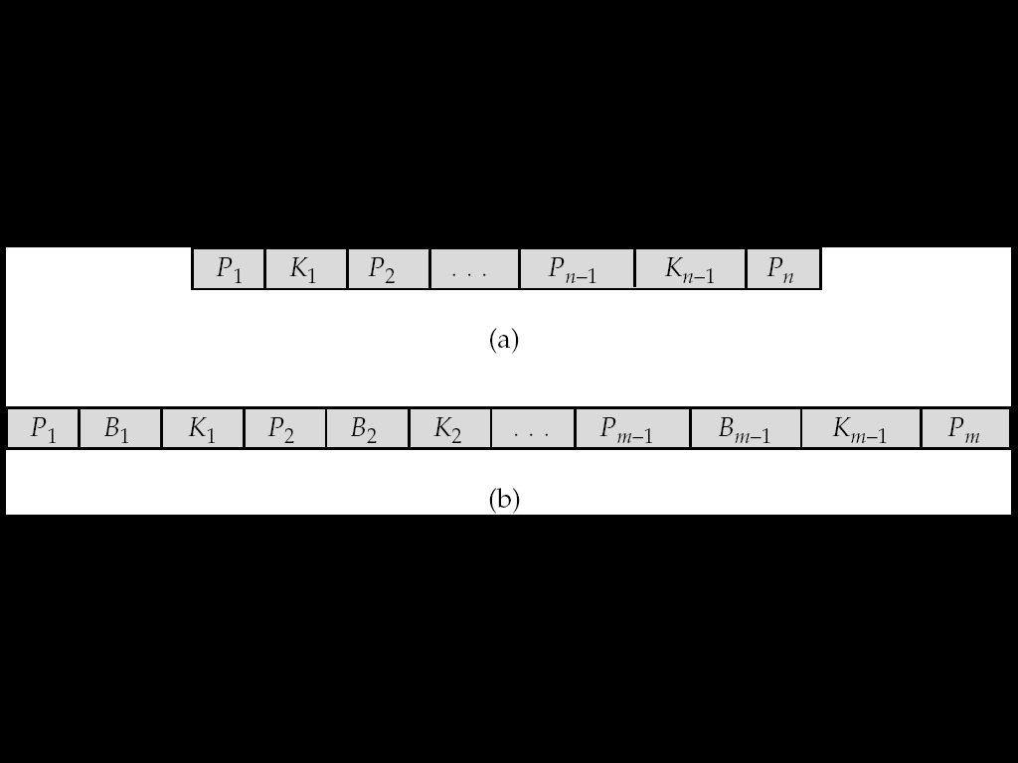
Indexing and Hashing
B-Tree Index Files
A generalized B-tree leaf node and a non-leaf node appear in Fig. (a) and Fig. (b) respectively.

Slide 51
Indexing and Hashing
B-Tree Index Files
Leaf nodes are the same as in B+ trees. In nonleaf nodes, the pointers P_{i} are the tree pointers that we used also for B+ trees, while the pointers B_{i} are bucket or file-record pointers. In the generalized B-tree in the figure, there are n – 1 keys in the leaf node, but there are m − 1 keys in the nonleaf node. This discrepancy occurs because nonleaf nodes must include pointers B_{i}, thus reducing the number of search keys that can be held in these nodes.
Advantages of B-Tree indices
May use less tree nodes than a corresponding B⁺ Tree.
Sometimes possible to find search-key value before reaching leaf node.

Slide 52
Indexing and Hashing
Disadvantages of B-Tree indices
Only small fraction of all search-key values are found early.
Non-leaf nodes are larger, so fan-out is reduced. Thus, B-Trees typically have greater depth than corresponding B⁺ Tree
Insertion and deletion more complicated than in B⁺ Trees.
Implementation is harder than B⁺ Trees.

Slide 53
Indexing and Hashing
Construct a B- tree for the following set of key values:
(2, 3, 5, 7, 11, 17, 19, 23, 29, 31) for n=4 and n=6.
Solution: Construction of B- tree for order n=4.
Search key values =3, Pointers= 4.
Insert key value 2:
Insert key value 3:
 | 2
 | 2 |  | 3

Slide 54
Indexing and Hashing
Construct a B- tree for the following set of key values:
(2, 3, 5, 7, 11, 17, 19, 23, 29, 31) for n=4 and n=6.
Solution:
Insert key value 5:
Insert key value 7:
 | 2 |  | 3 |  | 5
 |  | 5
 | 2 |  | 3
 | 7

Slide 55
Indexing and Hashing
Construct a B- tree for the following set of key values:
(2, 3, 5, 7, 11, 17, 19, 23, 29, 31) for n=4 and n=6.
Solution:
Insert key value 11:
Insert key value 17:
 |  | 5
 | 2 |  | 3
 | 7 |  | 11
 |  | 5
 | 2 |  | 3
 | 7 |  | 11 |  | 17

Slide 56
Indexing and Hashing
Construct a B- tree for the following set of key values:
(2, 3, 5, 7, 11, 17, 19, 23, 29, 31) for n=4 and n=6.
Solution:
Insert key value 19:
Insert key value 23:
 |  | 5 |  |  | 17
 | 2 |  | 3
 | 7 |  | 11
 | 19
 |  | 5 |  |  | 17
 | 2 |  | 3
 | 7 |  | 11
 | 19 |  | 23

Slide 57
Indexing and Hashing
Construct a B- tree for the following set of key values:
(2, 3, 5, 7, 11, 17, 19, 23, 29, 31) for n=4 and n=6.
Solution:
Insert key value 29:
 |  | 5 |  |  | 17
 | 2 |  | 3
 | 7 |  | 11
 | 19 |  | 23 |  | 29

Slide 58
Indexing and Hashing
Construct a B-tree for the following set of key values:
(2, 3, 5, 7, 11, 17, 19, 23, 29, 31) for n=4 and n=6.
Solution:
Insert key value 31:
5
17
29
2
3
7
11
19
23
31

Slide 59
Indexing and Hashing
Hashing
One disadvantage of sequential file organization is that we must use an index structure to locate data. File organizations based on the technique of hashing allow us to avoid accessing an index structure. Hashing also provides a way of constructing indices.
File organizations based on hashing allow us to find the address of a data item directly by computing a function on the search-key value of the desired record.

Slide 60
Indexing and Hashing
Hash File Organization
In a hash file organization, we obtain the address of the disk block, also called the bucket containing a desired record directly by computing a function on the search-key value of the record.
Let K denote the set of all search-key values, and let B denote the set of all bucket addresses. A hash function h is a function from K to B. Let h denote a hash function.
To insert a record with search key K_{i}, we compute h(K_{i}), which gives the address of the bucket for that record. Assume for now that there is space in the bucket to store the record. Then, the record is stored in that bucket.

Slide 61
Indexing and Hashing
Hash File Organization
To perform a lookup on a search-key value K_{i}, we simply compute h(K_{i}), then search the bucket with that address. Suppose that two search keys, K₅ and K₇, have the same hash value; that is, h(K₅) = h(K₇). If we perform a lookup on K₅, the bucket h(K₅) contains records with search-key values K₅ and records with search key values K₇. Thus, we have to check the search-key value of every record in the bucket to verify that the record is one that we want.

Slide 62
Indexing and Hashing
Hash File Organization: An Example
Let us choose a hash function for the account file using the search key branch_name.
Suppose we have 26 buckets and we define a hash function that maps names beginning with the ith letter of the alphabet to the ith bucket.
This hash function has the virtue of simplicity, but it fails to provide a uniform distribution, since we expect more branch names to begin with such letters as B and R than Q and X.

Slide 63
Indexing and Hashing
Hash File Organization: An Example
Instead, we consider 10 buckets and a hash function that computes the sum of the binary representations of the characters of a key, then returns the sum modulo the number of buckets.
For branch name ‘Perryridge’
Bucket no=h(Perryridge) = 5
For branch name ‘Round Hill’
Bucket no=h(Round Hill) = 3
For branch name ‘Brighton’
Bucket no=h(Brighton) = 3

Slide 64
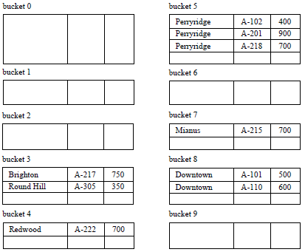
Indexing and Hashing
Hash File Organization: An Example

Slide 65
Indexing and Hashing
Handling of Bucket Overflows
In case of insertion, if the bucket does not have enough space, a bucket overflow is said to occur. Bucket overflow can occur mainly for two reasons:
Insufficient buckets. The number of buckets n_{B} must be chosen such that n_{B} > n_{r}/f_{r}, where n_{r} denotes the total number of records that will be stored and f_{r} denotes the number of records that will fit in a bucket.
Skew. Some buckets are assigned more records than are others, so a bucket may overflow even when other buckets still have space. This situation is called bucket skew. Skew can occur for two reasons:
Multiple records may have the same search key.
The chosen hash function may result in non-uniform distribution of search keys.

Slide 66
Indexing and Hashing
Handling of Bucket Overflows
Solution:
If a record must be inserted into a bucket b, and b is already full, the system provides an overflow bucket for b, and inserts the record into the overflow bucket. If the overflow bucket is also full, the system provides another overflow bucket, and so on. All the overflow buckets of a given bucket are chained together in a linked list.

Slide 67
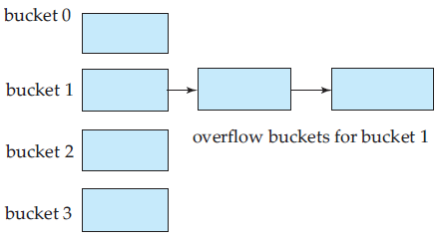
Indexing and Hashing
Handling of Bucket Overflows

Slide 68
Indexing and Hashing
Difference between open and closed hashing
Closed Hashing:
Closed hashing always places keys with same hash function values in same bucket (in overflow buckets also).
If bucket is full, the system inserts records in overflow buckets.
Different buckets can be of different sizes.
Overflow buckets are linked together.

Slide 69
Indexing and Hashing
Difference between open and closed hashing
Open Hashing:
Open hashing places keys with same hash function values in different bucket if a bucket is full.
Set of buckets is fixed there is no overflow chain
Deletion is difficult in open hashing.

Slide 70
Indexing and Hashing
Hash Indices
Hashing can be used not only for file organization, but also for index-structure creation.
We construct a hash index as follows. We apply a hash function on a search key to identify a bucket, and store the key and its associated pointers in the bucket.

Slide 71
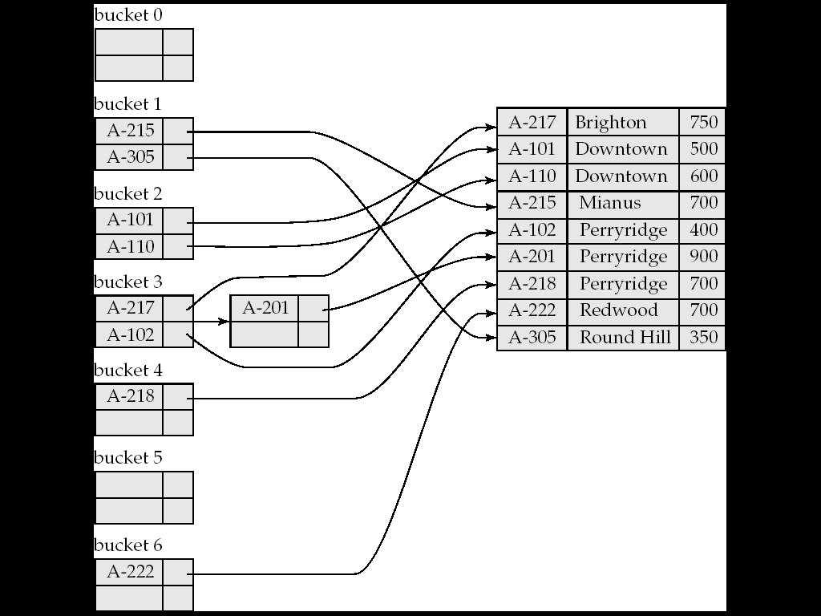
Indexing and Hashing
Hash Indices

